Slide 1
Thanksgiving!
By Morghan Brock & Linsey ROgers

Slide 2
What is thanksgiving about? How does your family celebrate Thanksgiving?

Slide 4
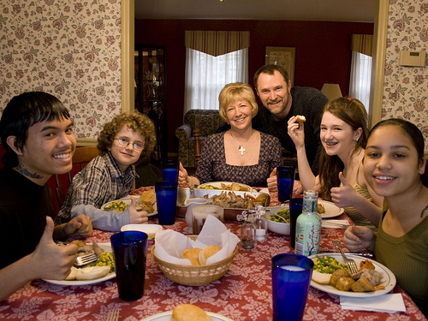

Slide 6
Why do we eat certain foods on thanksgiving?

Slide 12
What do you know about the first thanksgiving?

